Slide 1
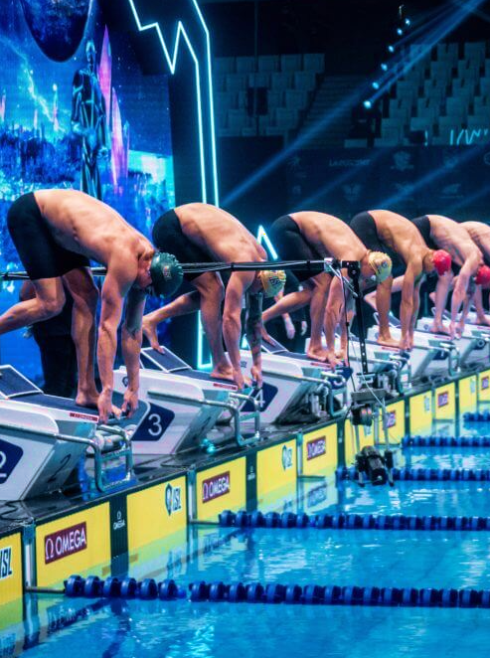



Fatigue Monitoring & Injury Prevention in Elite Swimmers
Legenda tabelas feito no ppt
Ver se treinos e testes nao estao trocados
Hugo Veríssimo 124348
João Cardoso 50750
Foundations of Machine Learning 24/25

Slide 2
cONTENTS
Project Overview
Data Analysis
Machine Learning models
Results
Conclusions

Slide 3
Project Overview

Slide 4
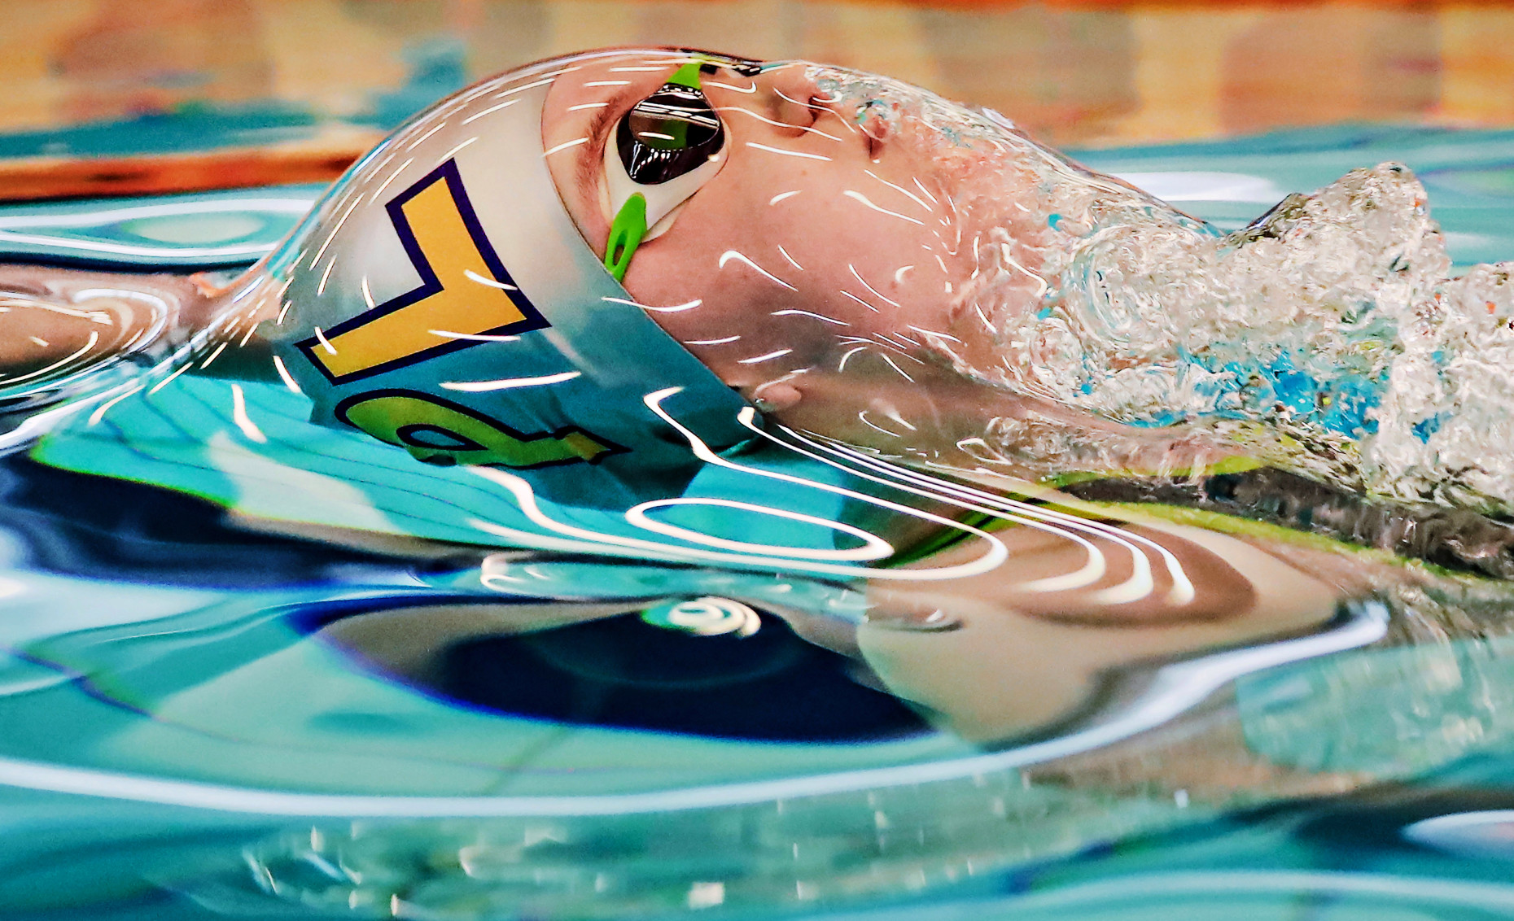
The ProbleM
Improving performance of elite athletes is the ultimate goal of any sports coach.
Balance between workload and rest is crucial.
Too high effort, may lead to injury, too low and some gains may be left on the table.

Slide 5

State of the Art
Fatigue and injury prediction using ML models, such as Logistic Regression, Random Forest, Support Vector Machine, among others, across different sports contexts.
Feature engineering and selection is among the most debated topics.
Overfitting problems.

Slide 6

Methodology
Raw Data
Data Assessment
Data Normalization
Train Multiple ML Models
Model Evaluation
Deploy Best Model
Logistic Regression
Support Vector Machine
Decision Tree
StandardScaler
Recall
F1-Score
Accuracy
Learning Curve
Confusion Matrix
Precision
train_test_split
RandomizedSearchCV

Slide 7
Data Analysis

Slide 8
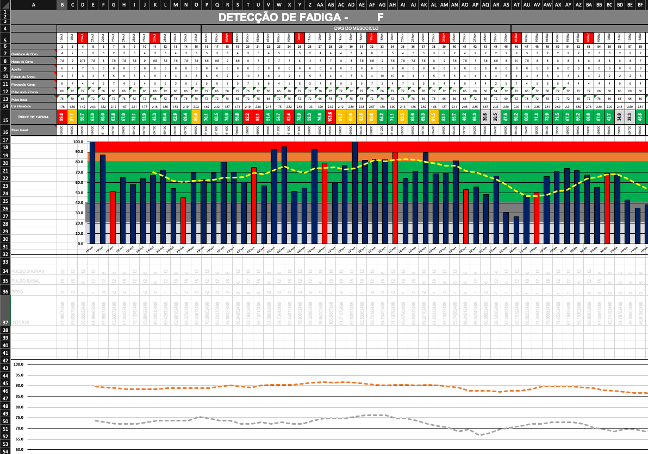
RAW DATA
Swimming club CAPGE
Season 2019/2020
7 athletes
11 different metrics
Around 200 obs. per athlete

Slide 9
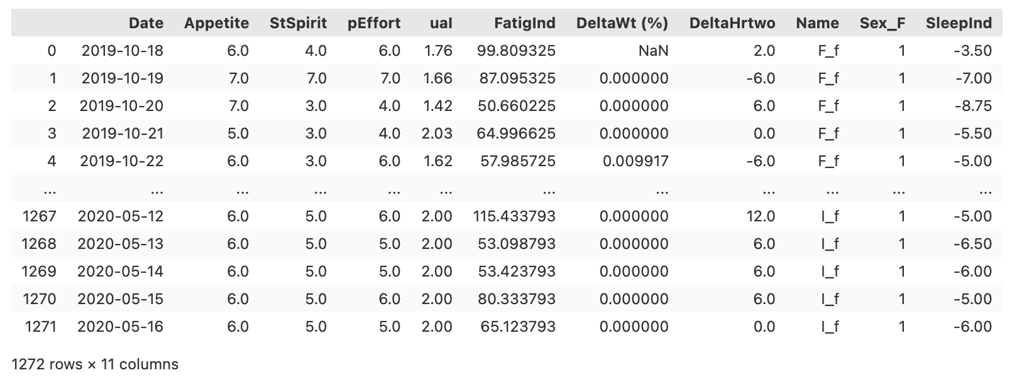
structured data

Slide 10

Feature engineering
The figure, illustrating the periodicity of training loads, highlights the dynamic nature of fatigue.
Using EWMA helps to manage this complexity.

Slide 11
Overcoming Data Challenges
SMOTE and random undersampling
Random oversampling and undersampling

Slide 12
Feature Selection

Slide 13
Machine learning models

Slide 14
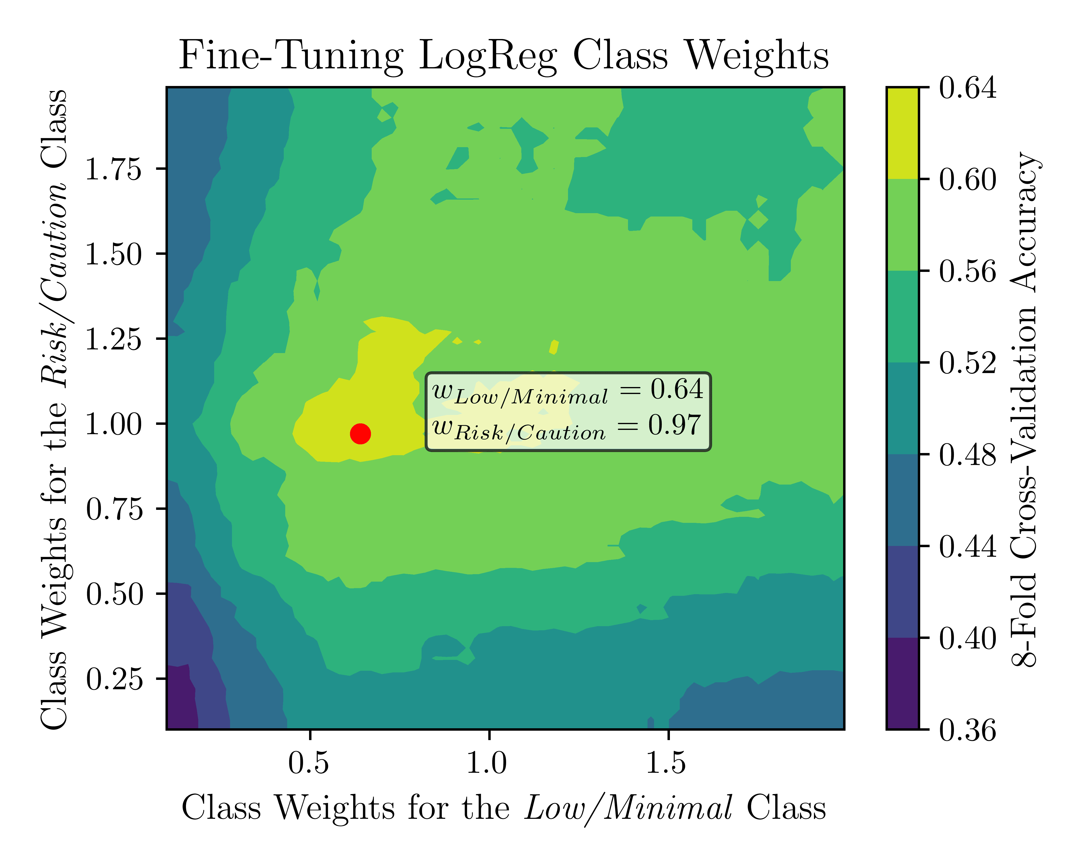
LOGISTIC REGRESSION

Slide 15
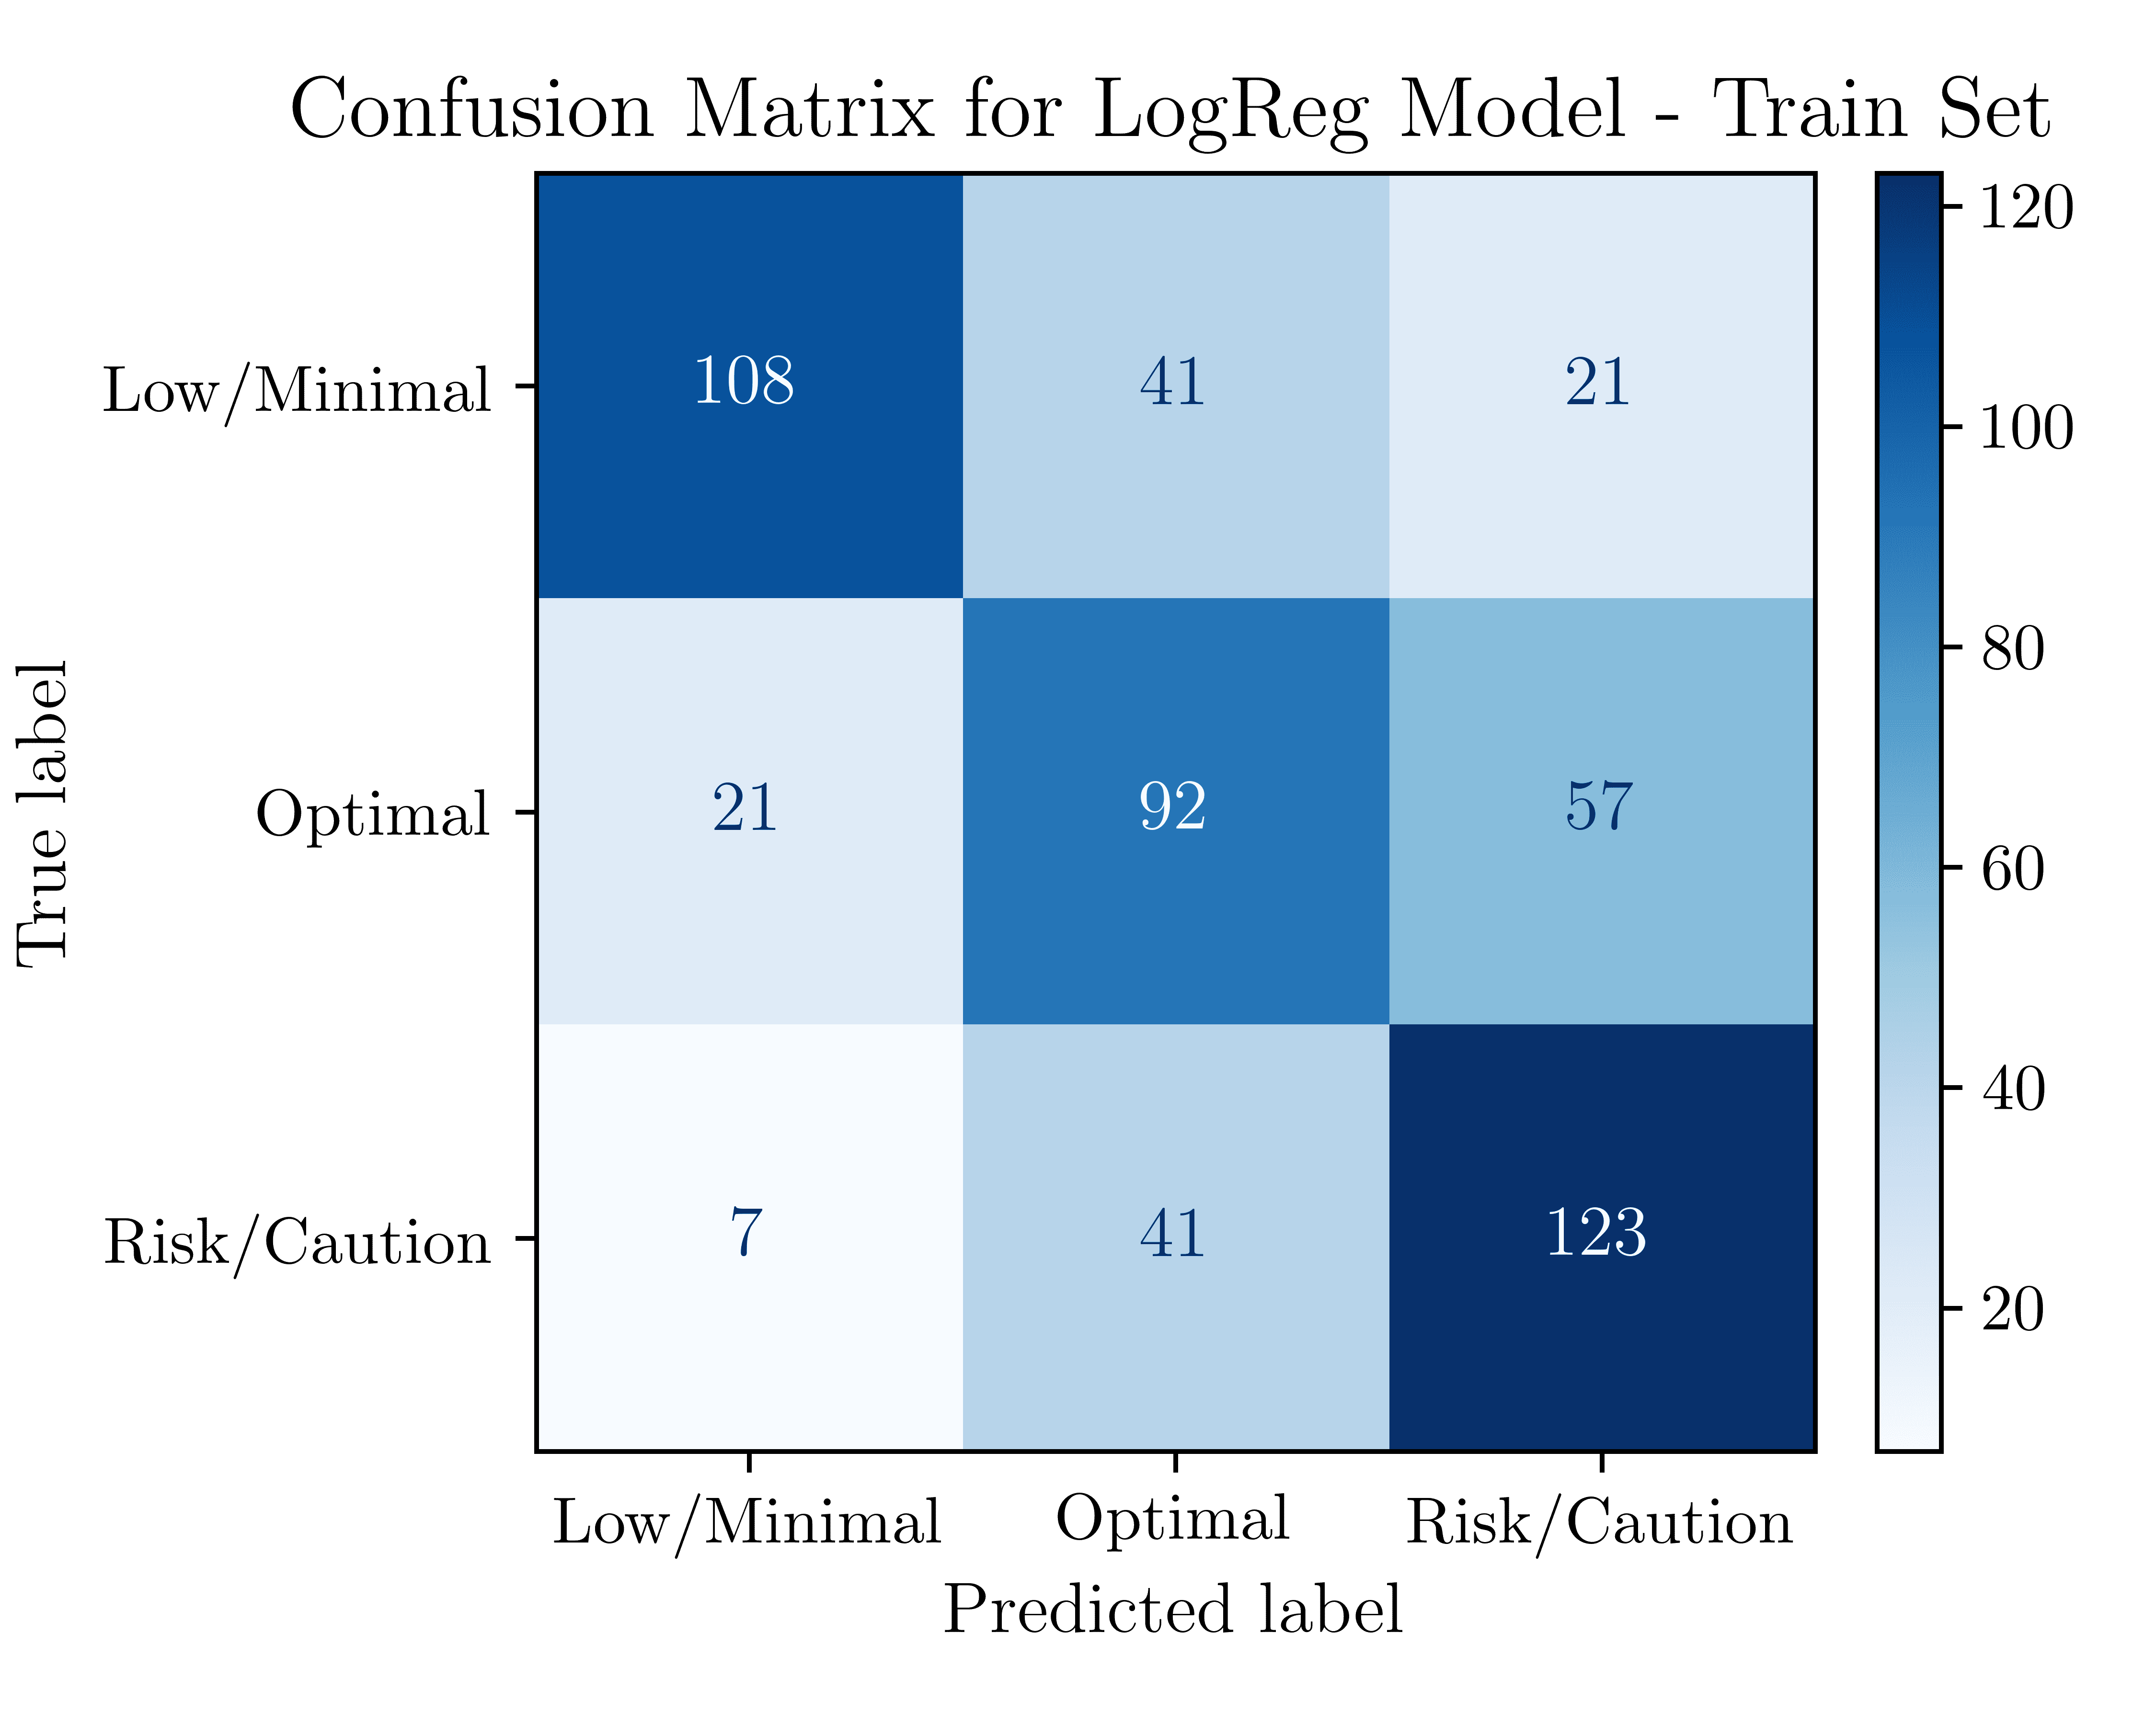
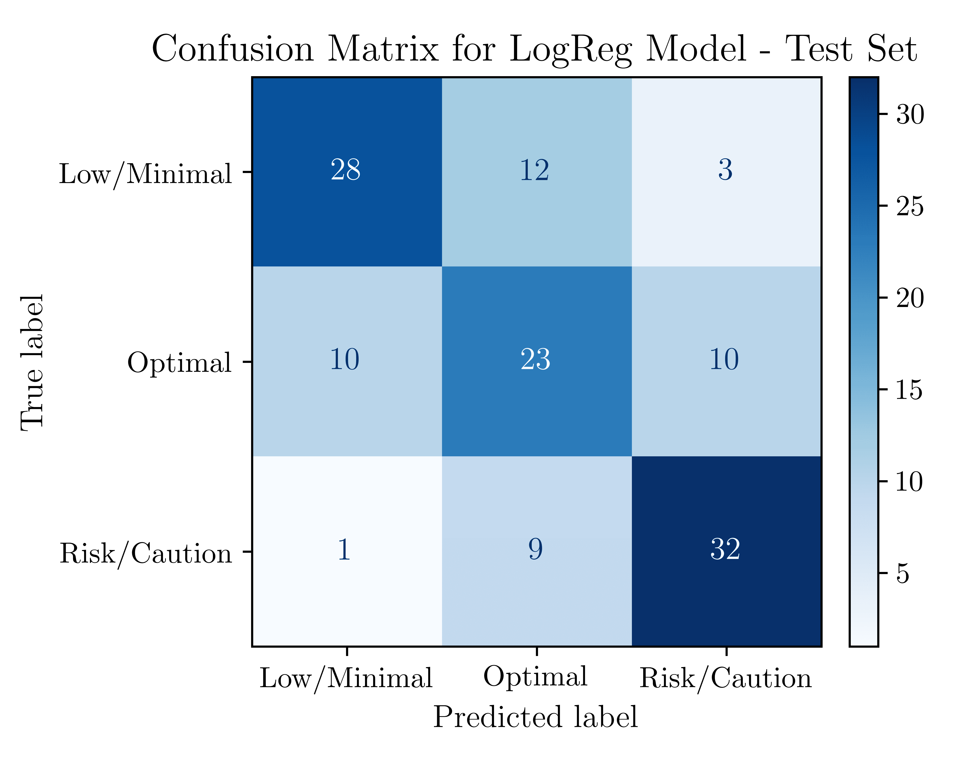
LOGREG RESULTS
Classification Report: Train Set
Classification Report: Test Set

Slide 16
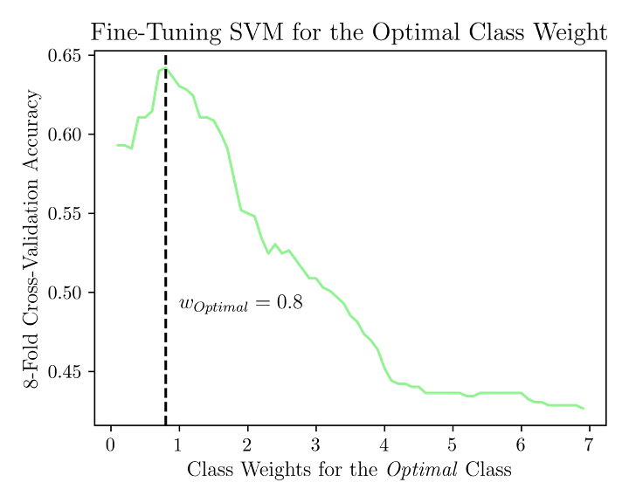
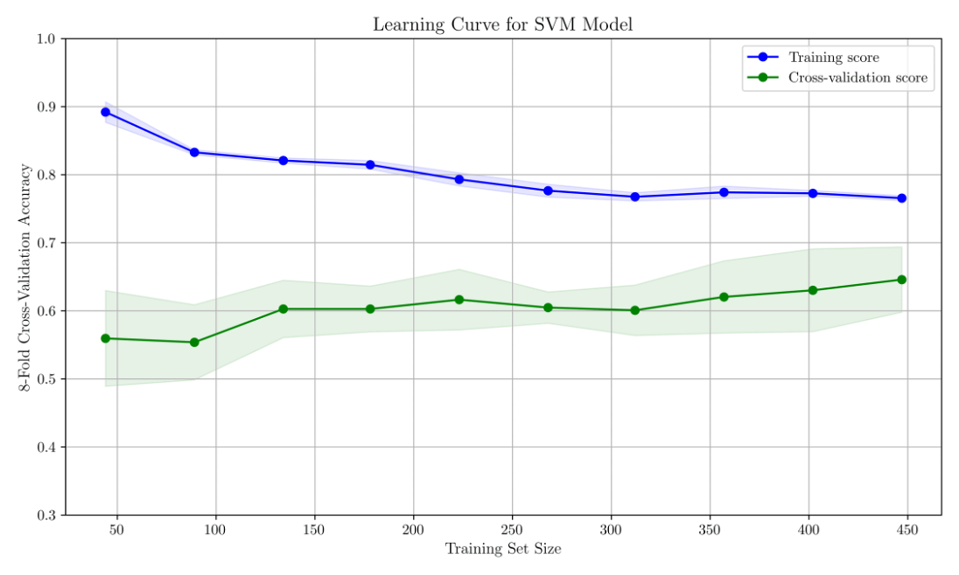
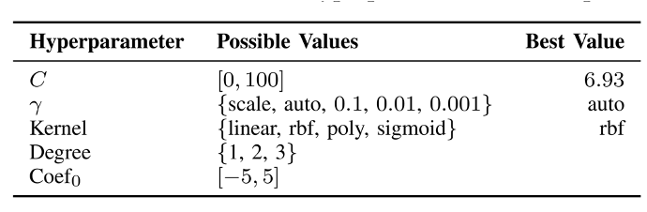
Support vector machine

Slide 17
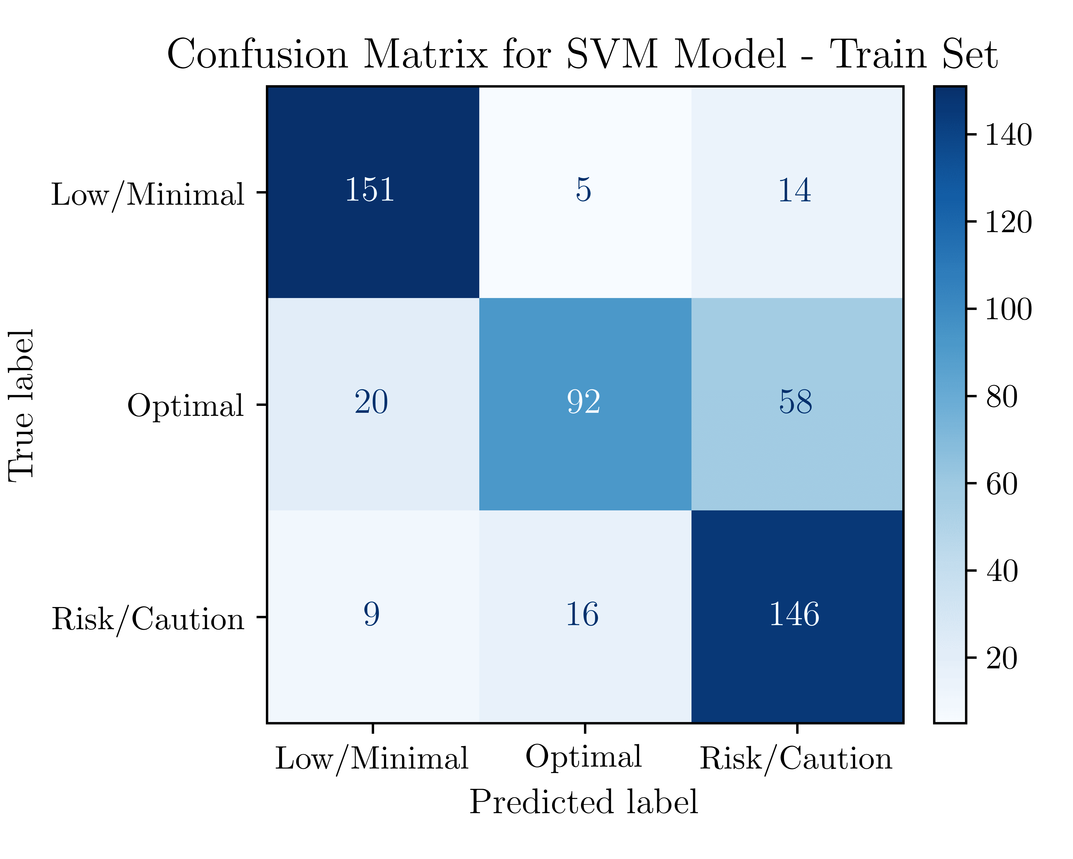
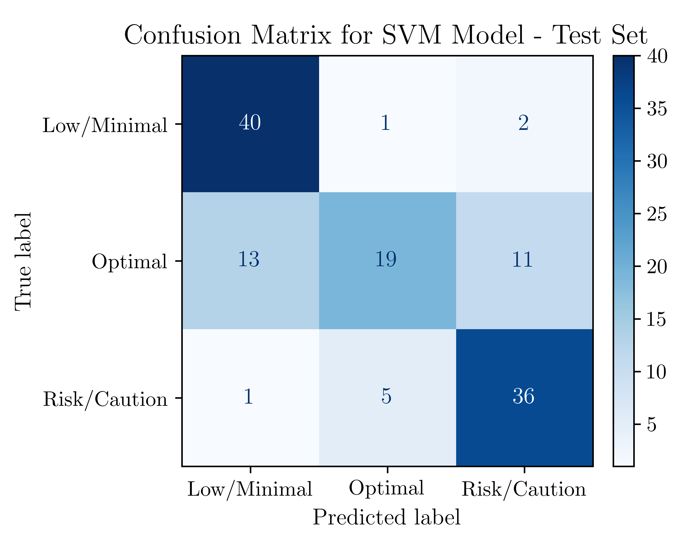
SVM RESULTS
Classification Report: Train Set
Classification Report: Test Set

Slide 18
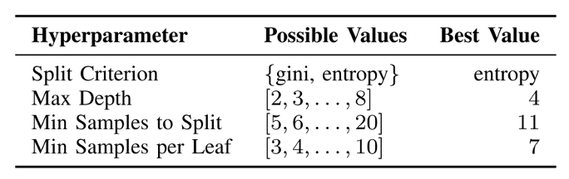
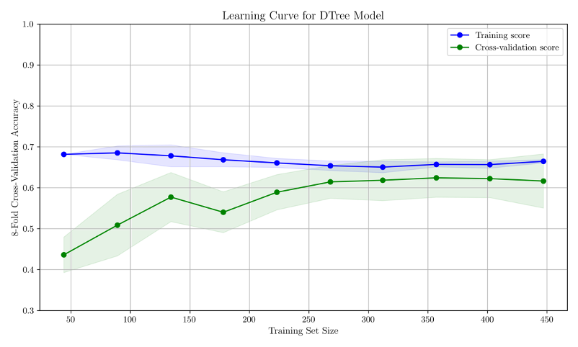
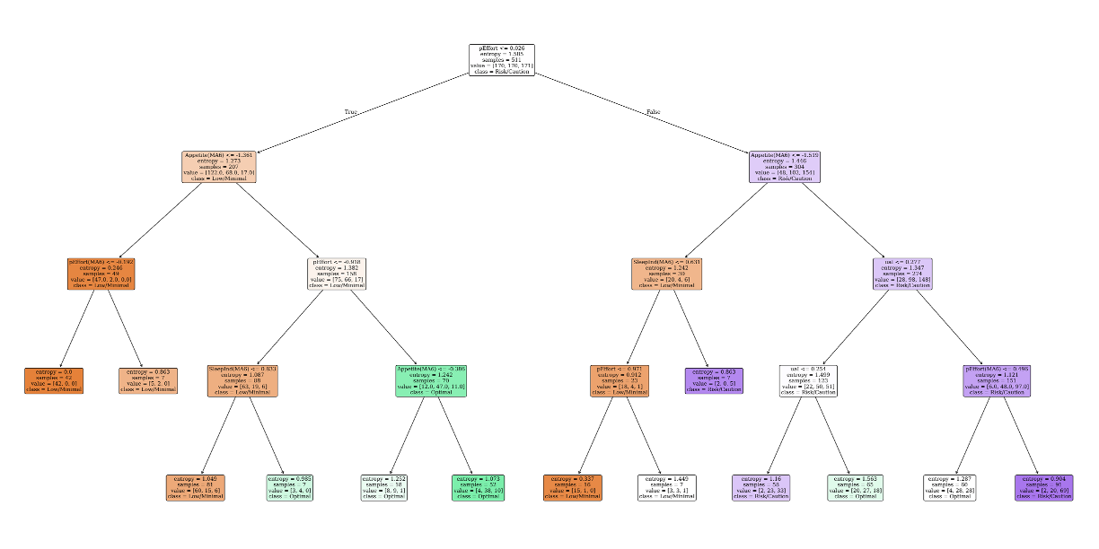
decision tree

Slide 19
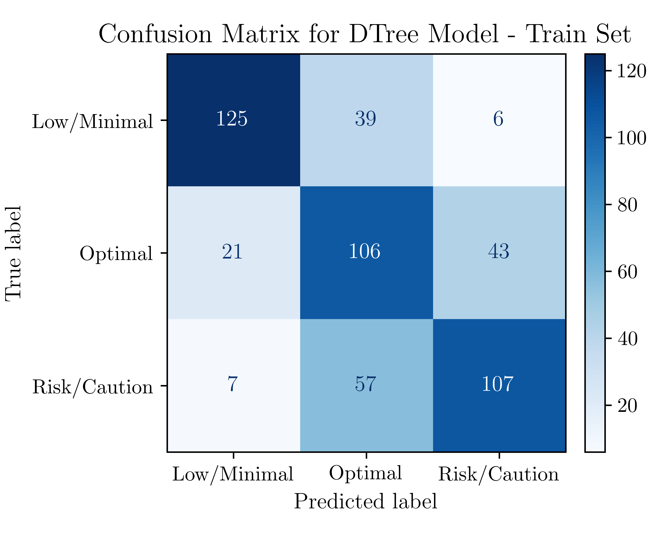
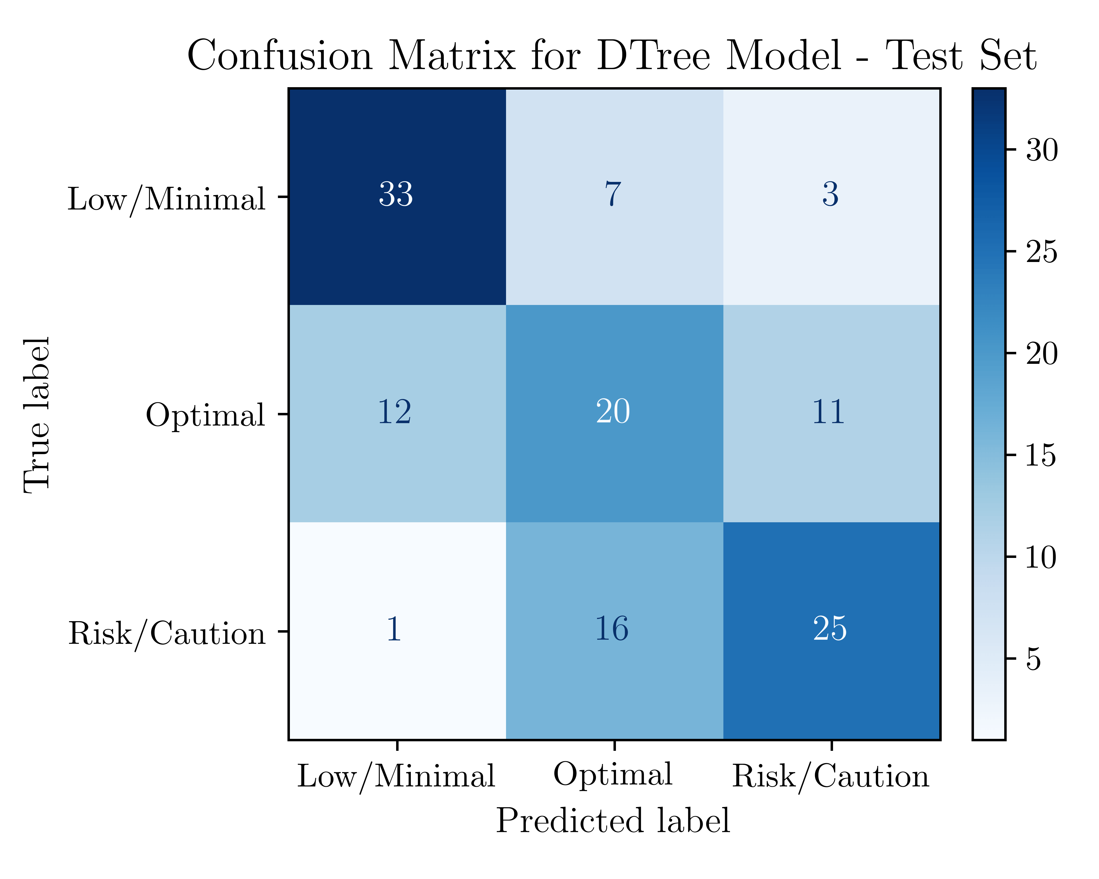
Dtree RESULTS
Classification Report: Train Set
Classification Report: Test Set

Slide 20
Results

Slide 21
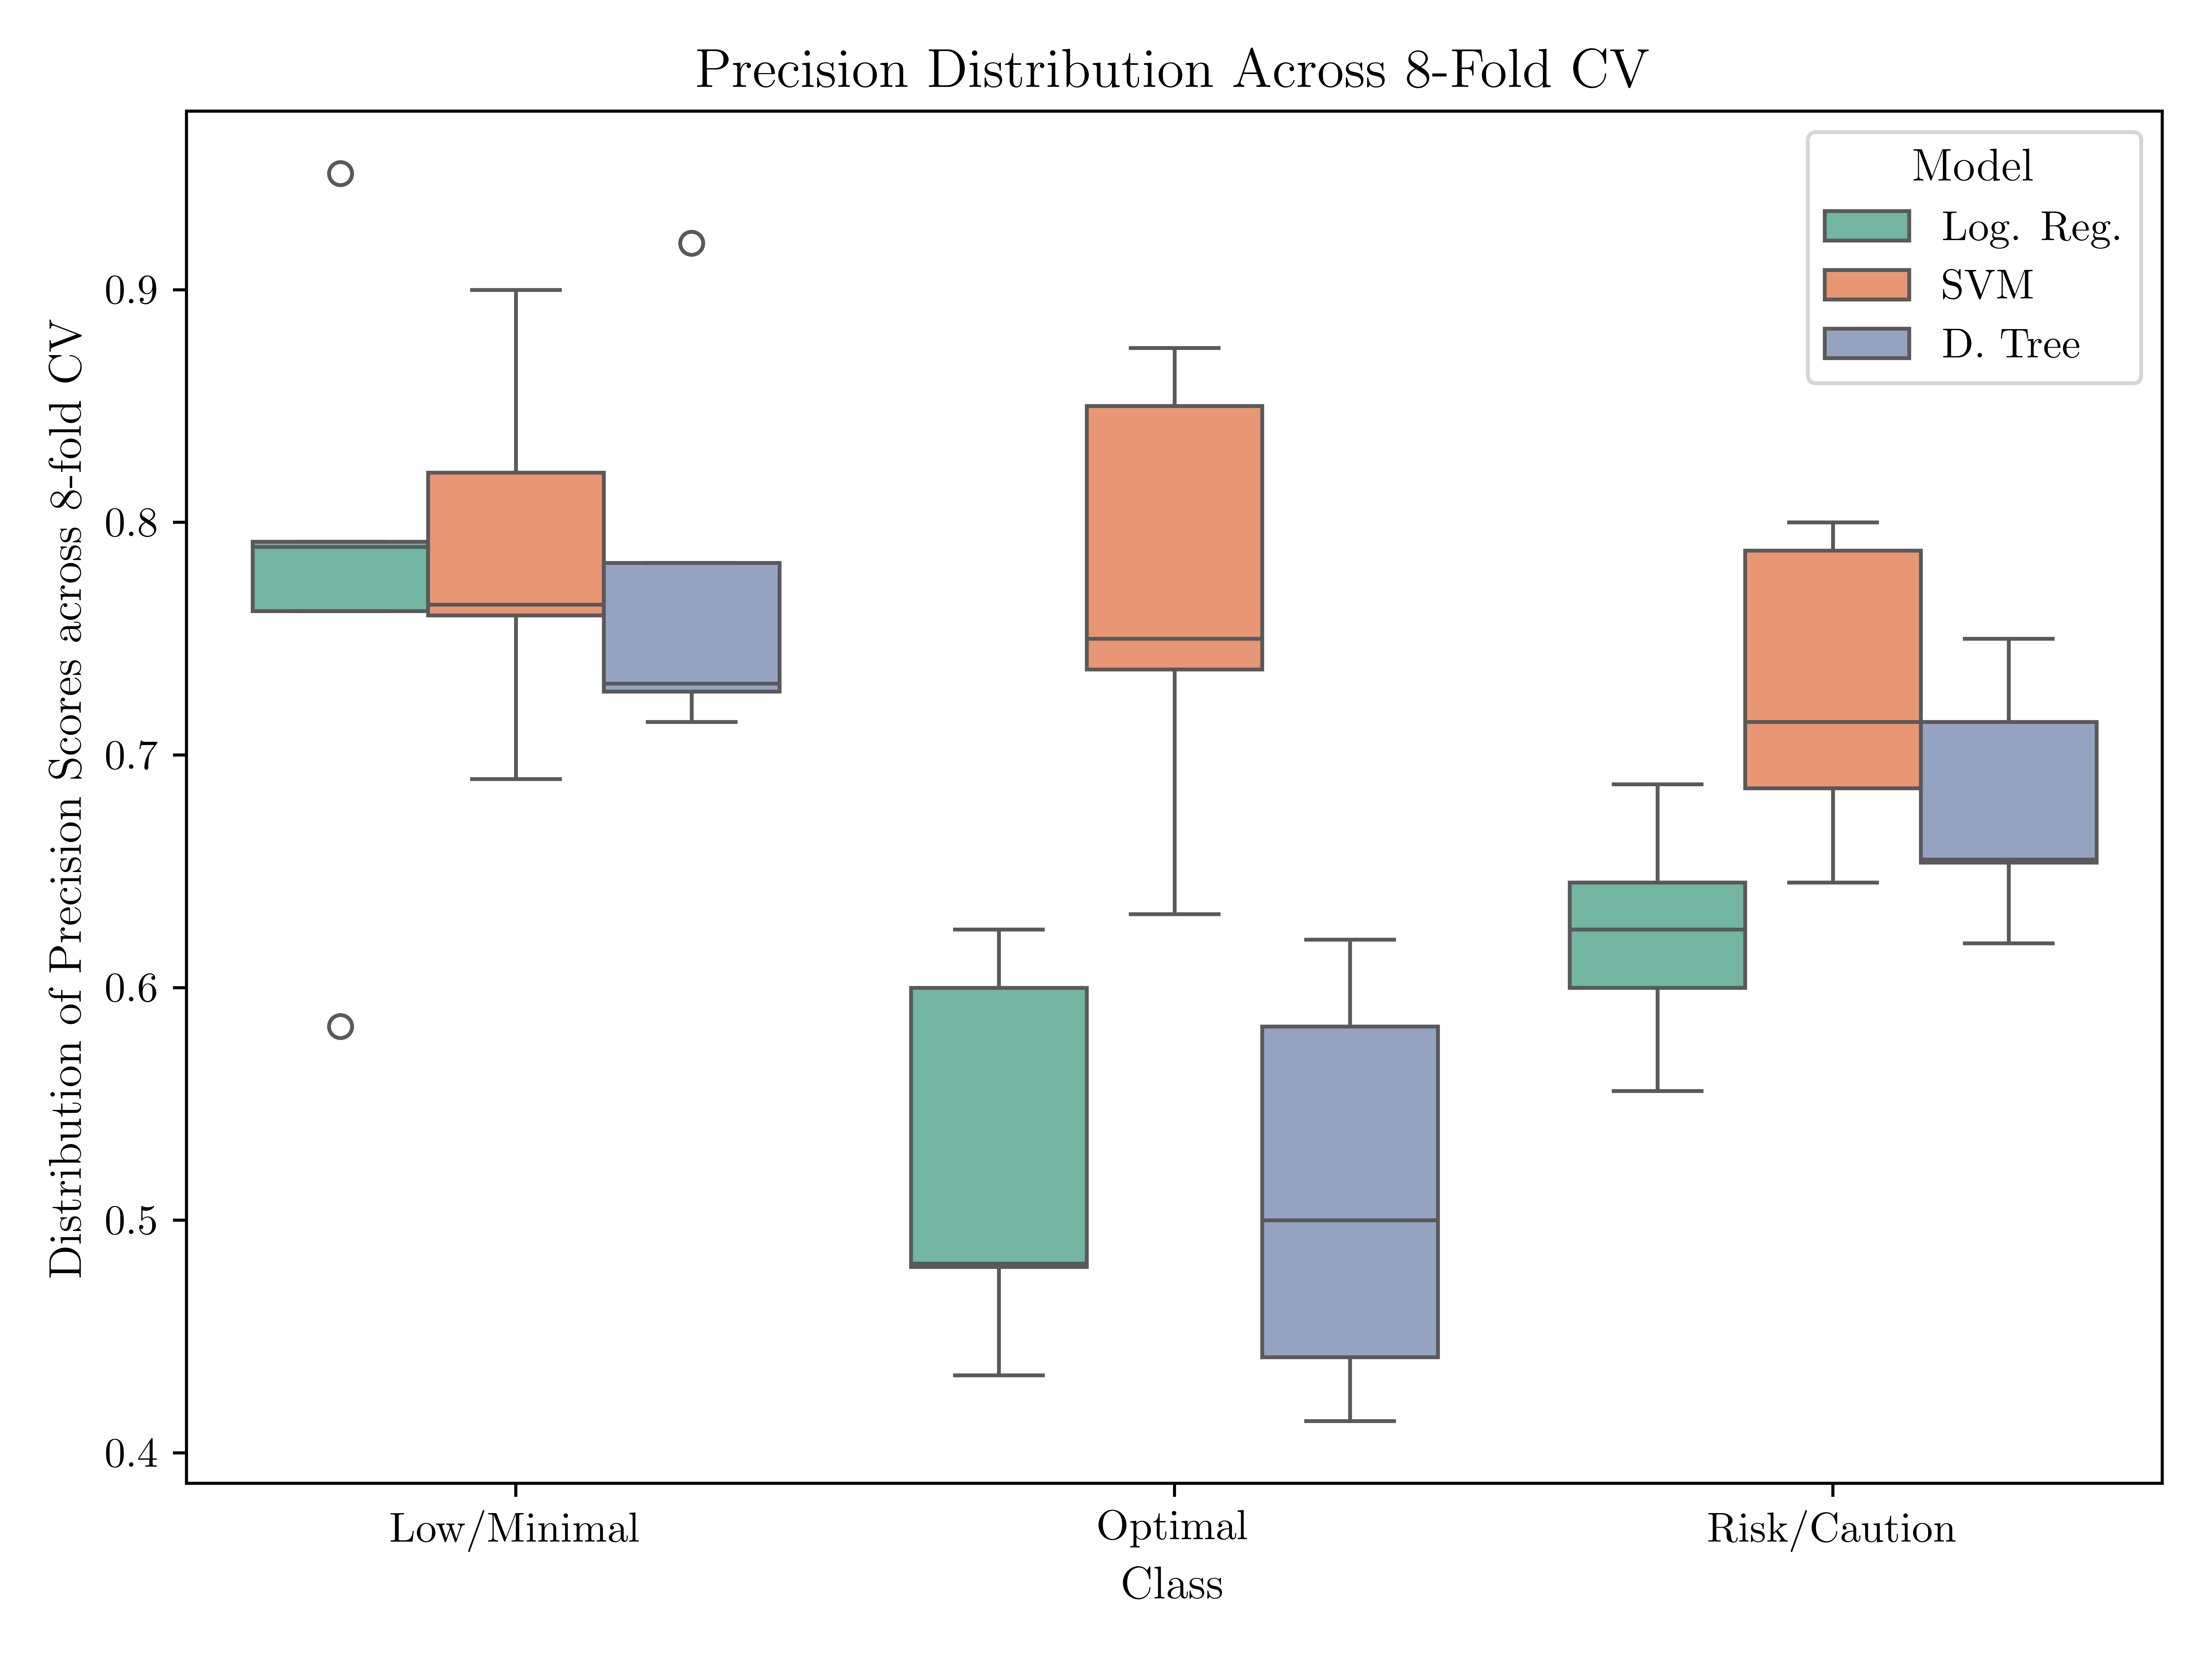
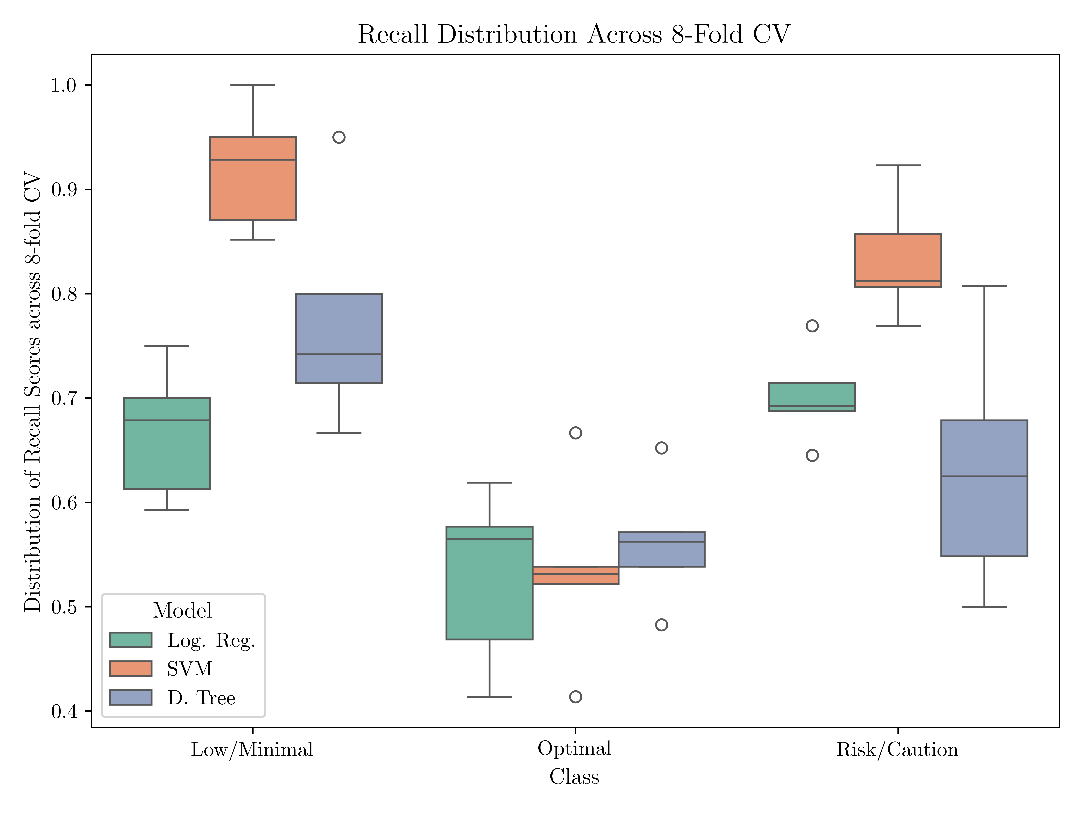
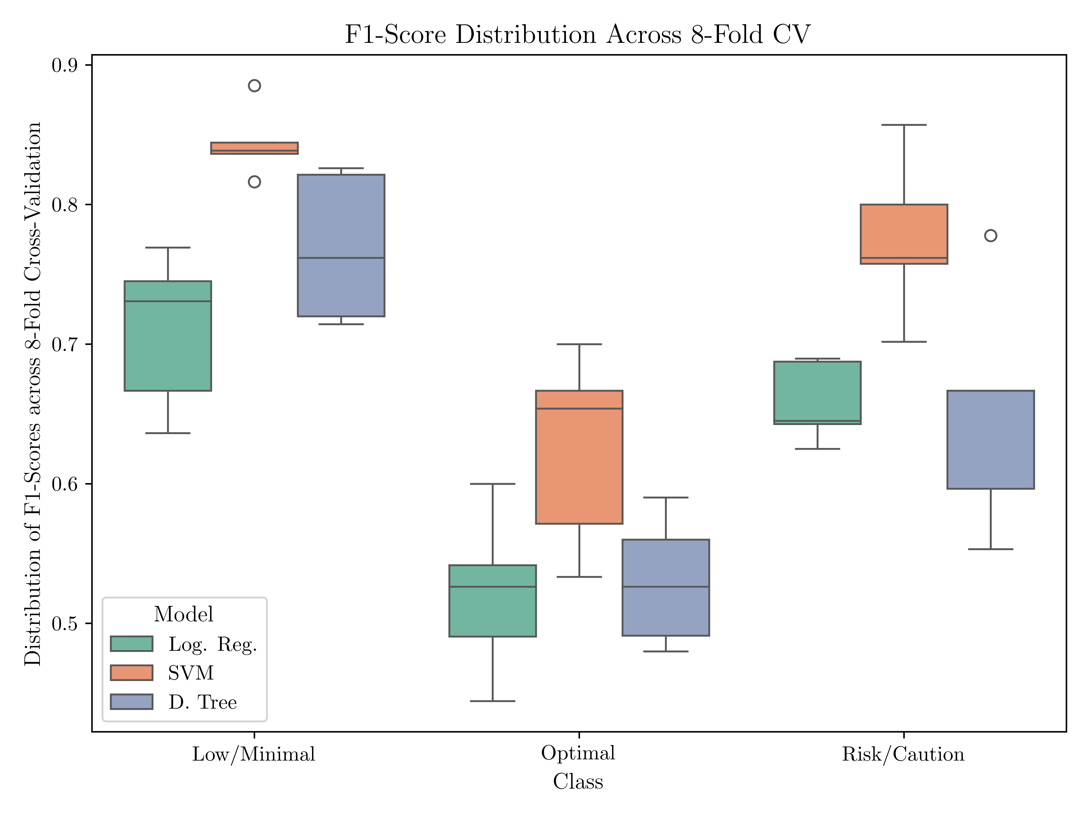
Performance Metrics

Slide 22
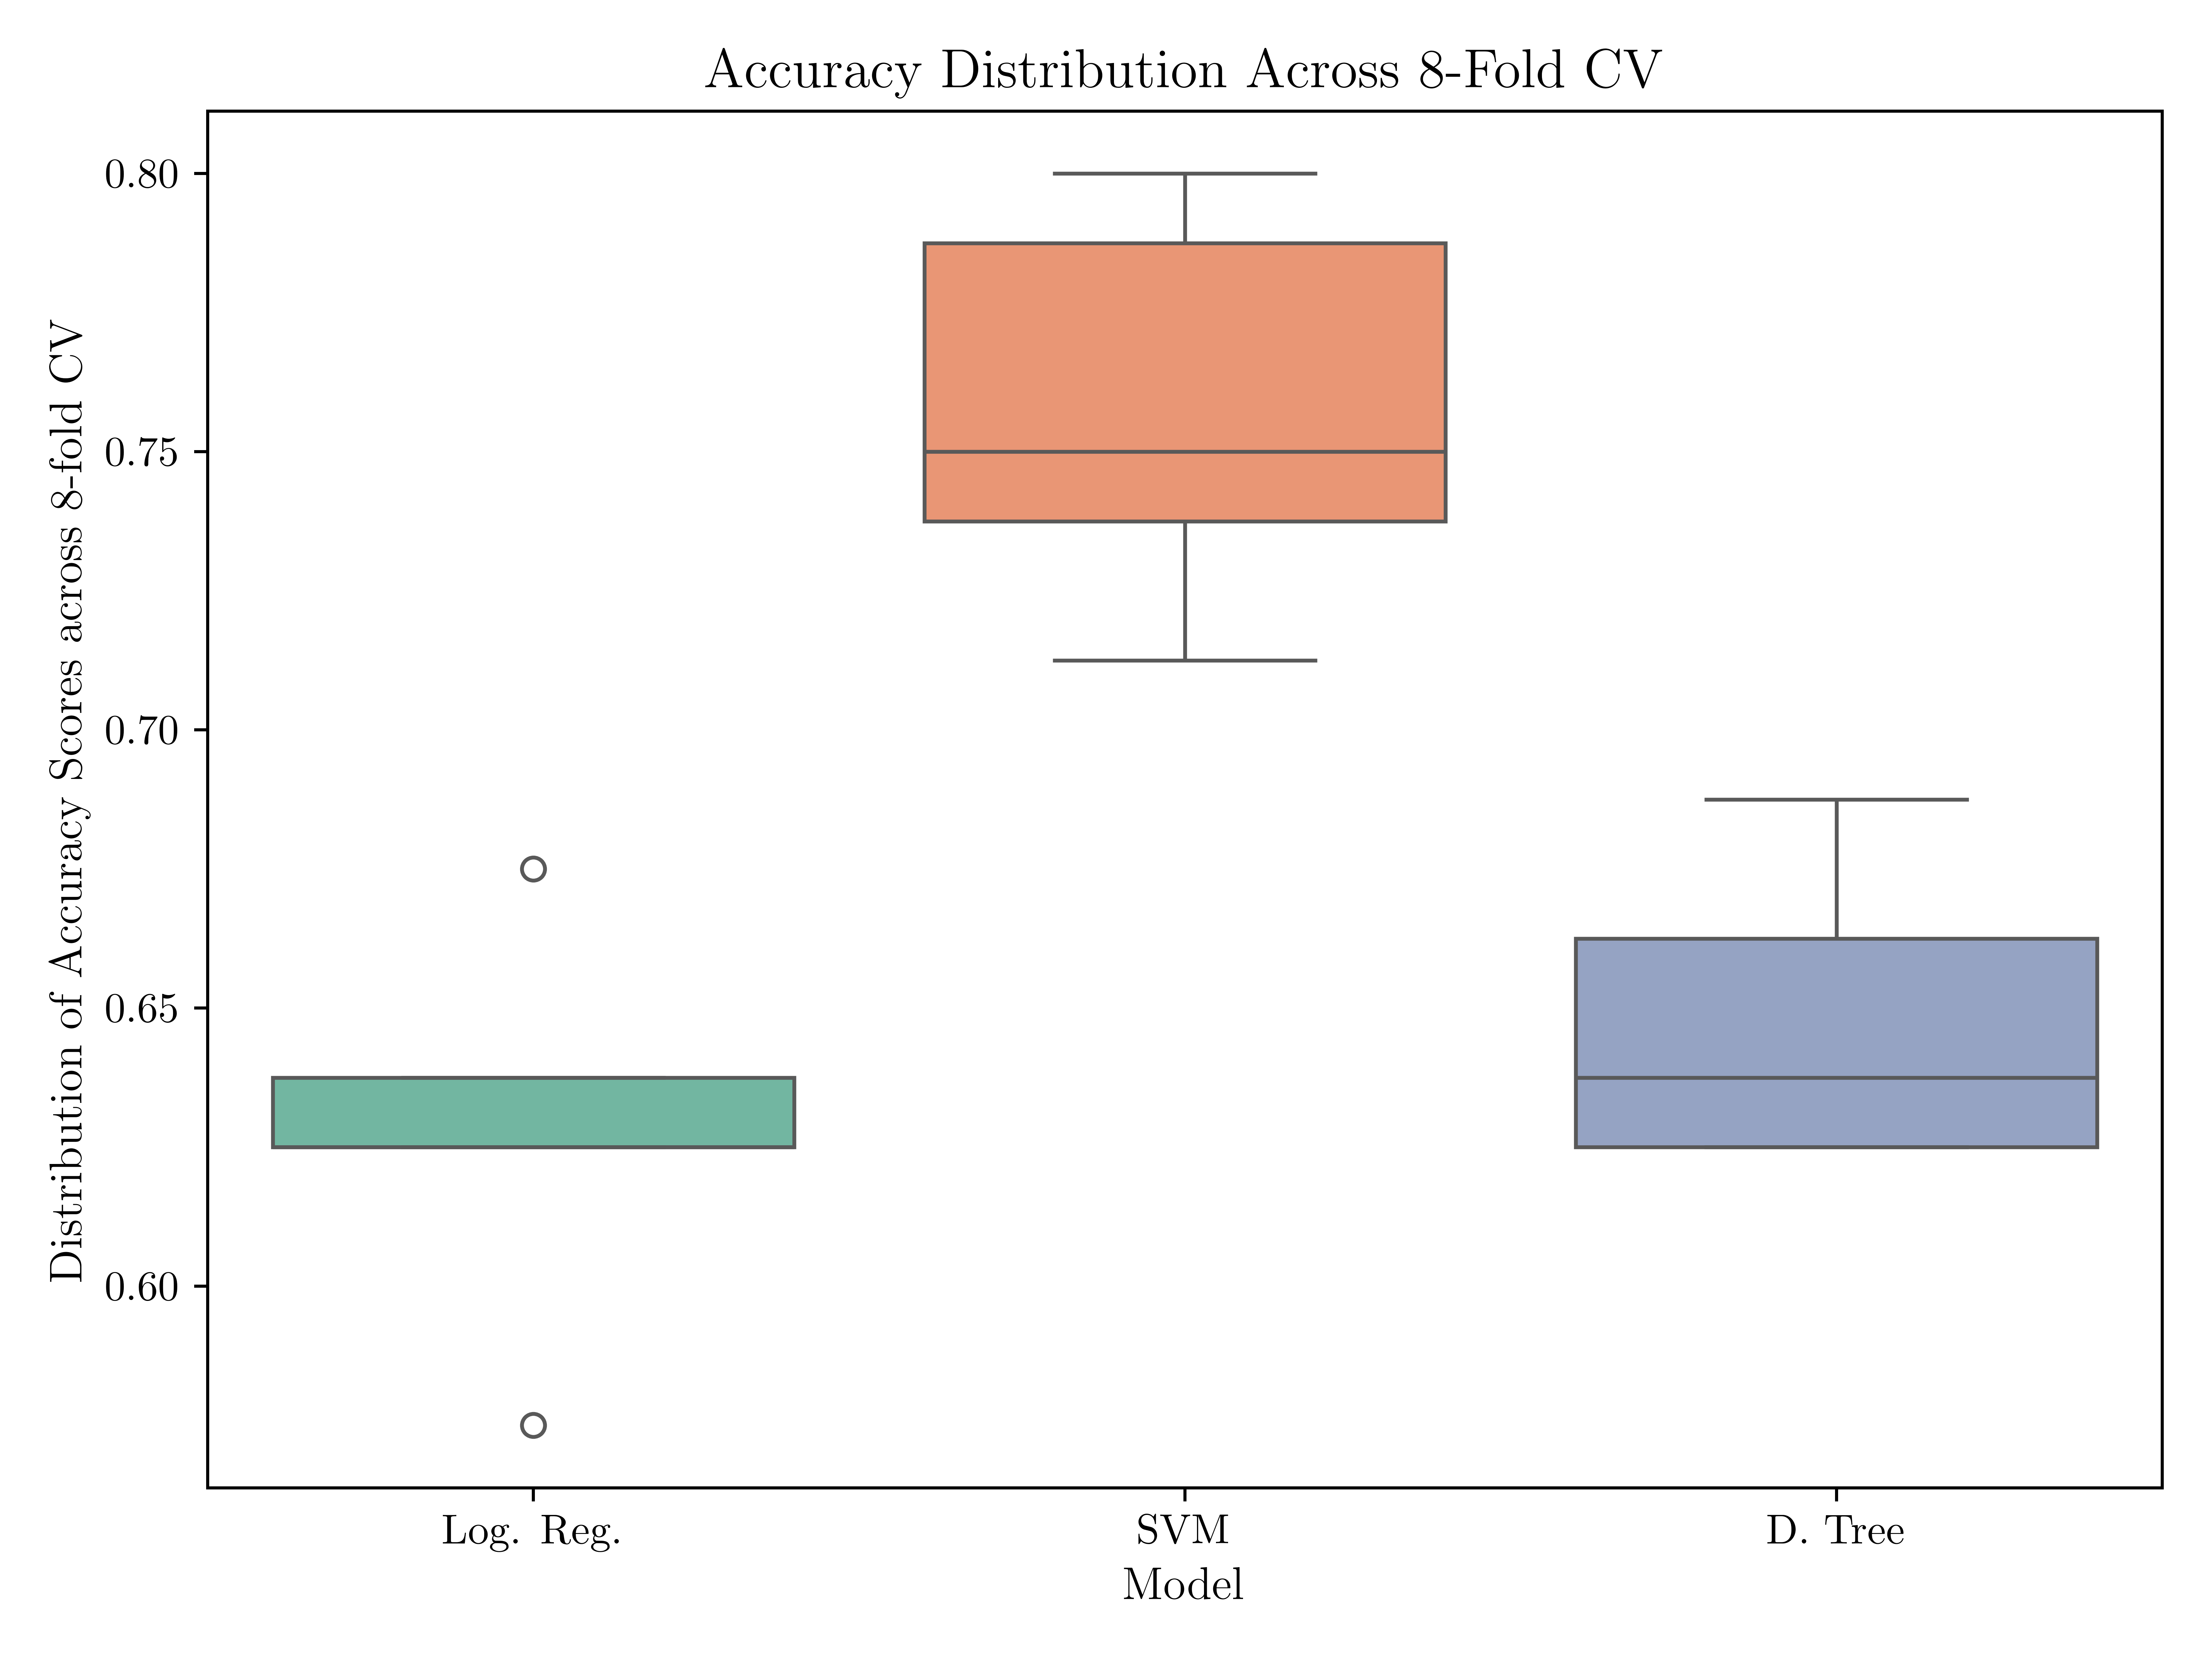
Performance Metrics

Slide 23

Decision Boundaries

Slide 24
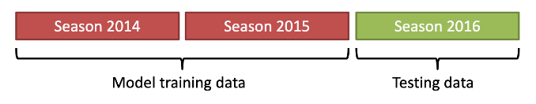
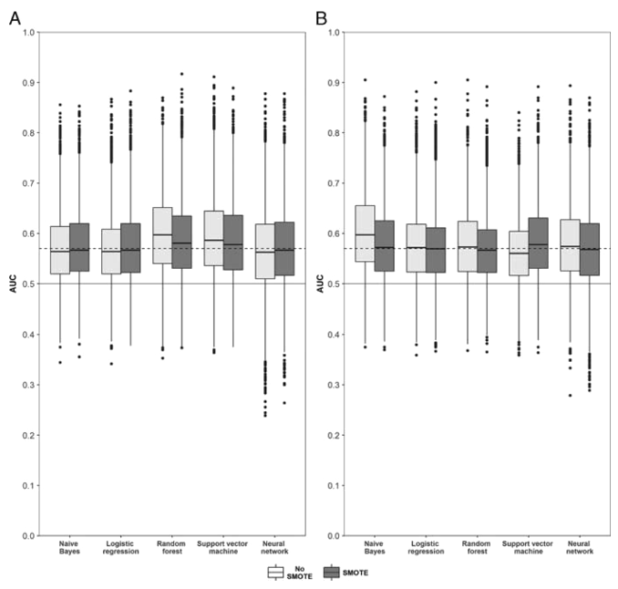
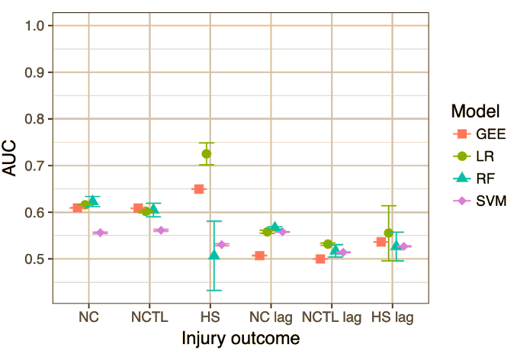
Literature Benchmark
“Predictive modelling of training loads and injury in australian football,” 2018, by Carey et al.
“Predictive modeling of hamstring strain injuries in elite australian footballers,” 2017, by Rudy et al.
Most literature focusing on injury prediction
Performance criteria not directly comparable:
Most of the problems are binary (injury or no injury)
Models developed are well aligned with those in the literature

Slide 25
Conclusions
Despite the reduced dataset, it was possible to implement and assess different machine learning models.
Of the three models tested (LogReg, SVM, DTree), the support vector machine model stood out as being the most consistent across the board.
The model performance is well in line with what is already published.
The model will be implemented in Excel format, and shared with the Head Coach Daniel Tavares.
Future work: follow-up on the implementation, and improve data collection for further refinement.

